Slide 1
PJLI: TalentConnex
Web Application
www.collaberadigital.com

Slide 2
PERSONAL BACKGROUND
Name : JOAGNE ANN F. FERNANDO
Past Experience : SOFTWARE DEVELOPMENT
Qualification : WEB DEVELOPMENT
Career Summary : I have experience in software development for both desktop and web applications using .NET technologies. Additionally, I have extensive experience in software documentation. In addition to my technical skills, I possess strong communication skills and the ability to collaborate effectively with team members and clients to achieve project goals and I am always eager to expand my skill set and take on new challenges in software development.

Slide 3
PERSONAL BACKGROUND
Name : RAPHAEL ISIAH L. RAMIREZ
Past Experience : SOFTWARE DEVELOPMENT
Qualification : MOBILE AND WEB DEVELOPMENT
Career Summary : As a quality-focused and detail-oriented software engineer, I possess one (1) year of extensive experience in software development. My skills and expertise encompass both frontend and backend development of web and mobile applications. I approach my work with a high level of professionalism and prioritize delivering exceptional results that align with industry standards.

Slide 4
PERSONAL BACKGROUND
Name : PRINCE JOSHUA M. GUINTU
Past Experience : SOFTWARE DEVELOPMENT
Qualification : WEB DEVELOPMENT
Career Summary : I am a committed and ambitious web developer, enthusiastic about exploring and excelling in this dynamic and ever-evolving industry. With a passion for innovation and a thirst for knowledge, I am eager to learn and adapt to new technologies, frameworks, and programming languages. My ultimate goal is to make a significant contribution to the field of web development while delivering exceptional results with utmost professionalism.

Slide 5
KEY TAKEAWAYS AND LEARNINGS FROM THE PROGRAM:
Development of a .NET Core MVC Web Application
Development of a .NET Core Web API
Working with Entity Framework in ASP.NET Core Web Applications and Web API
Working with ASP .NET Core Identity
Working with Repository Pattern in conjunction with Entity Framework
Application Deployment in Docker and Kubernetes

Slide 6
PROBLEM STATEMENT OF THE
CAPSTONE PROJECT
The capstone project intends to find answers on how to efficiently develop TalentConnex, a job posting web application that connects job searchers with relevant career openings in PJLI.
How to design a user-friendly user interface and job search experience for both job searchers and hiring managers?
How to provide a platform for employers and hiring managers in PJLI careers wherein they can publish accurate and detailed job postings for job seekers in their web portal?
How can job postings be efficiently categorized and filtered so that job searchers can easily search for and identify suitable job opportunities in PJLI careers based on their preferences?
How can job seekers easily submit applications to PJLI careers, and hiring managers simply access and download them without encountering any compatibility issues?
How to design a easy to use account management system that makes it simple for users to manage their resumes, update their personal and professional information, and monitor their job applications?

Slide 7
APPROACH NOTE
During the process of developing the capstone project, Business Requirements Documentation is created as to support the system's requirements and functionalities
Utilization of Figma – a collaborative interface design tool to create and design the wireframe of the application.
Usage of Draw.IO – to create the Entity-Relationship Diagram of the application
Development of the web application by using the ASP.NET Core MVC
Development of the WEB API
Deployment of the application by using Docker and Kubernetes

Slide 8

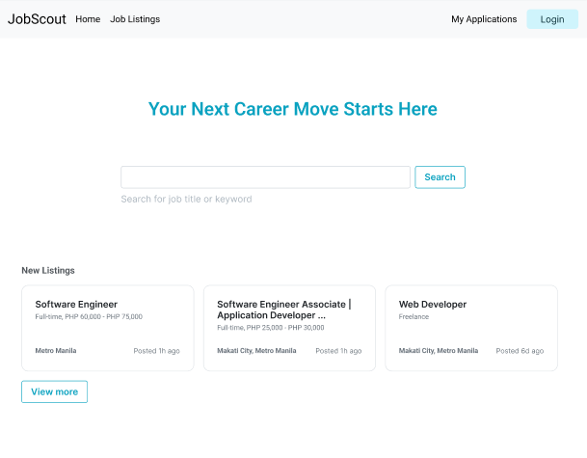

WIREFRAMES OF THE APPLICATION
ANONYMOUS - INDEX
www.collaberadigital.com

Slide 9
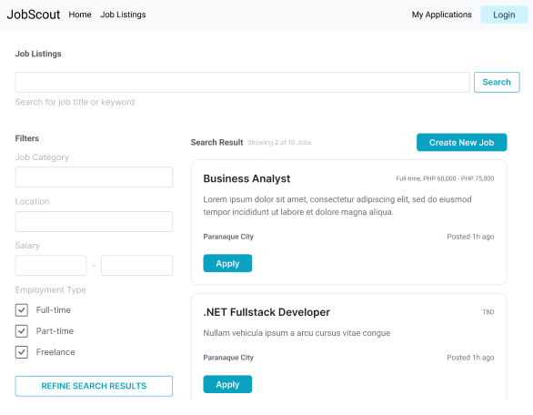
WIREFRAMES OF THE APPLICATION
ANONYMOUS - JOB LISTINGS
www.collaberadigital.com

Slide 10
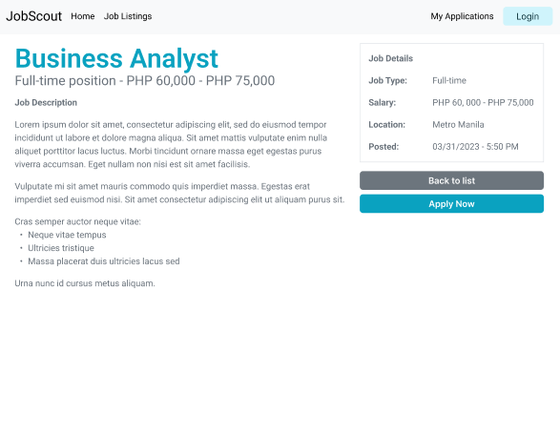
WIREFRAMES OF THE APPLICATION
ANONYMOUS - JOB DETAILS
www.collaberadigital.com

Slide 11
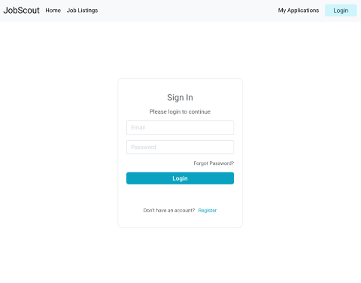
WIREFRAMES OF THE APPLICATION
ANONYMOUS – SIGN IN
www.collaberadigital.com

Slide 12
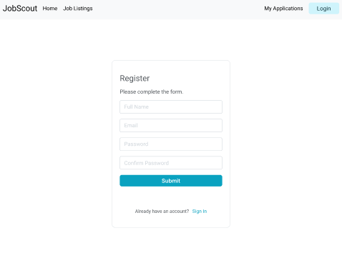
WIREFRAMES OF THE APPLICATION
ANONYMOUS – REGISTER
www.collaberadigital.com

Slide 13
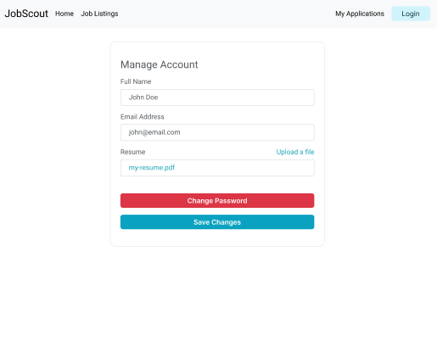
WIREFRAMES OF THE APPLICATION
MANAGE PROFILE - JOBSEEKER
NOTE: Display Resume field only when the user is a Jobseeker
www.collaberadigital.com

Slide 14
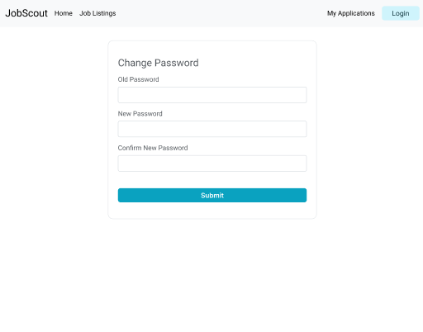
WIREFRAMES OF THE APPLICATION
CHANGE PASSWORD
www.collaberadigital.com

Slide 15
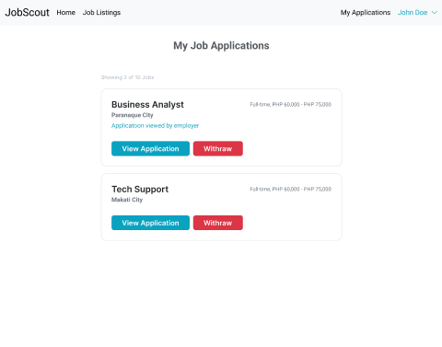
WIREFRAMES OF THE APPLICATION
JOBSEEKER – MY APPLICATION
www.collaberadigital.com

Slide 16
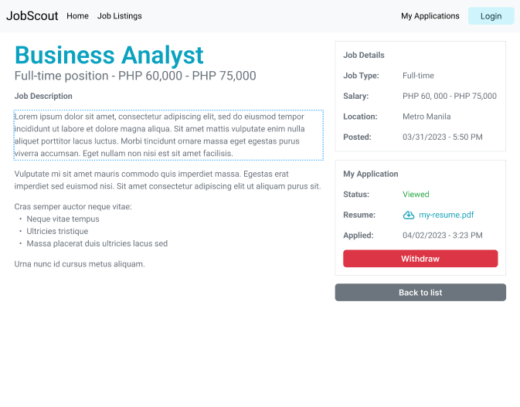
WIREFRAMES OF THE APPLICATION
JOBSEEKER – APPLICATION JOB DETAILS
www.collaberadigital.com

Slide 17
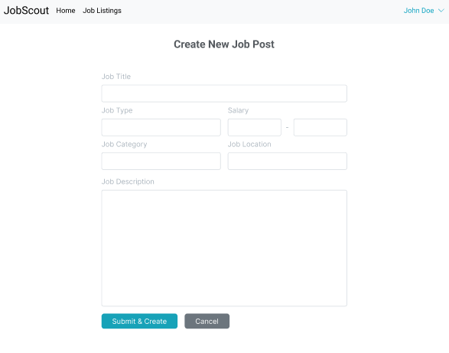
WIREFRAMES OF THE APPLICATION
EMPLOYER – CREATE/EDIT JOB POST
www.collaberadigital.com

Slide 18
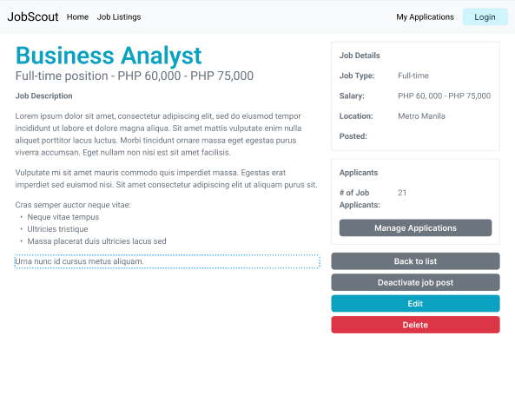
WIREFRAMES OF THE APPLICATION
EMPLOYER – JOB DETAILS
www.collaberadigital.com

Slide 19
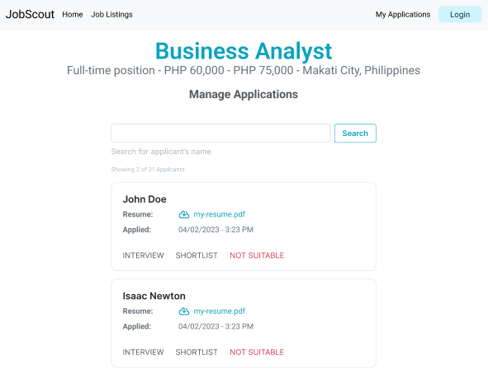
WIREFRAMES OF THE APPLICATION
EMPLOYER – MANAGE APPLICATION
www.collaberadigital.com

Slide 20
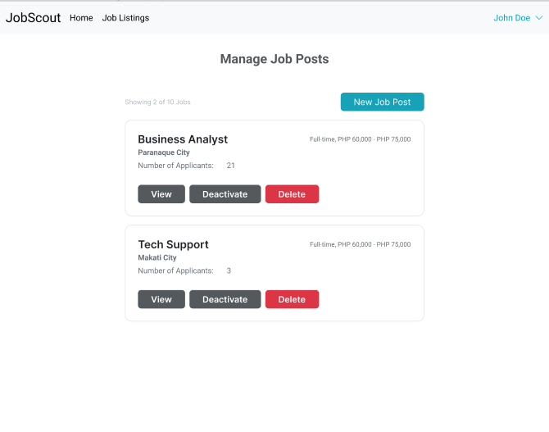
WIREFRAMES OF THE APPLICATION
EMPLOYER - JOB POST
www.collaberadigital.com

Slide 21
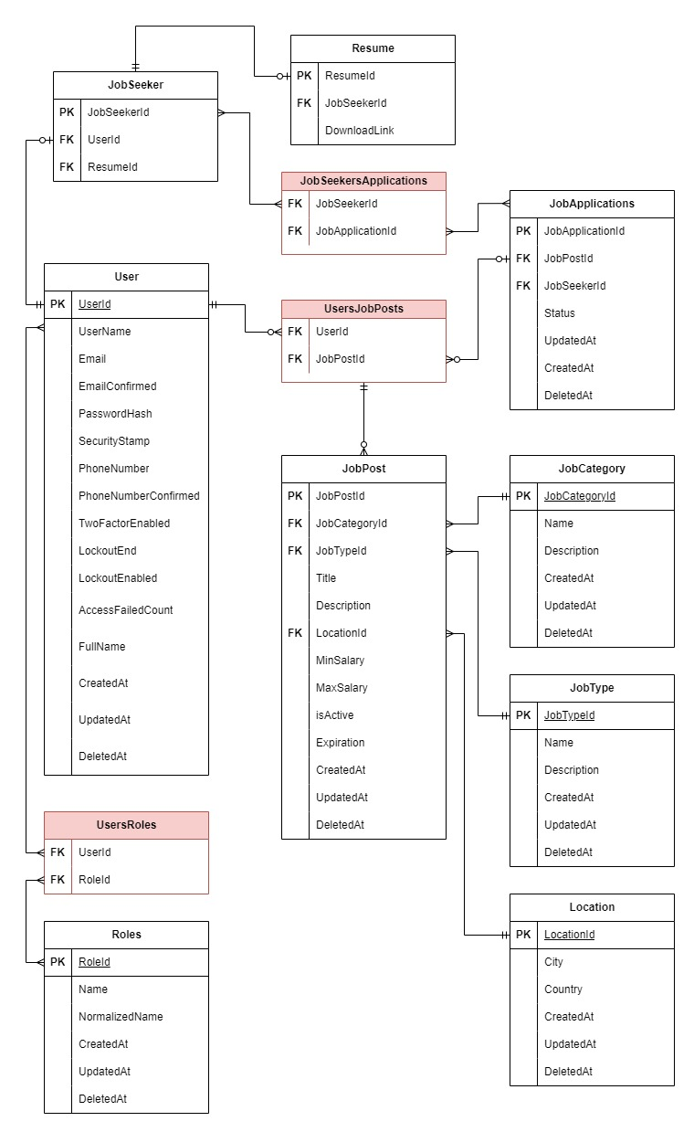
DATABASE OF THE APPLICATION
ENTITY - RELATIONSHIP DIAGRAM
www.collaberadigital.com

Slide 22
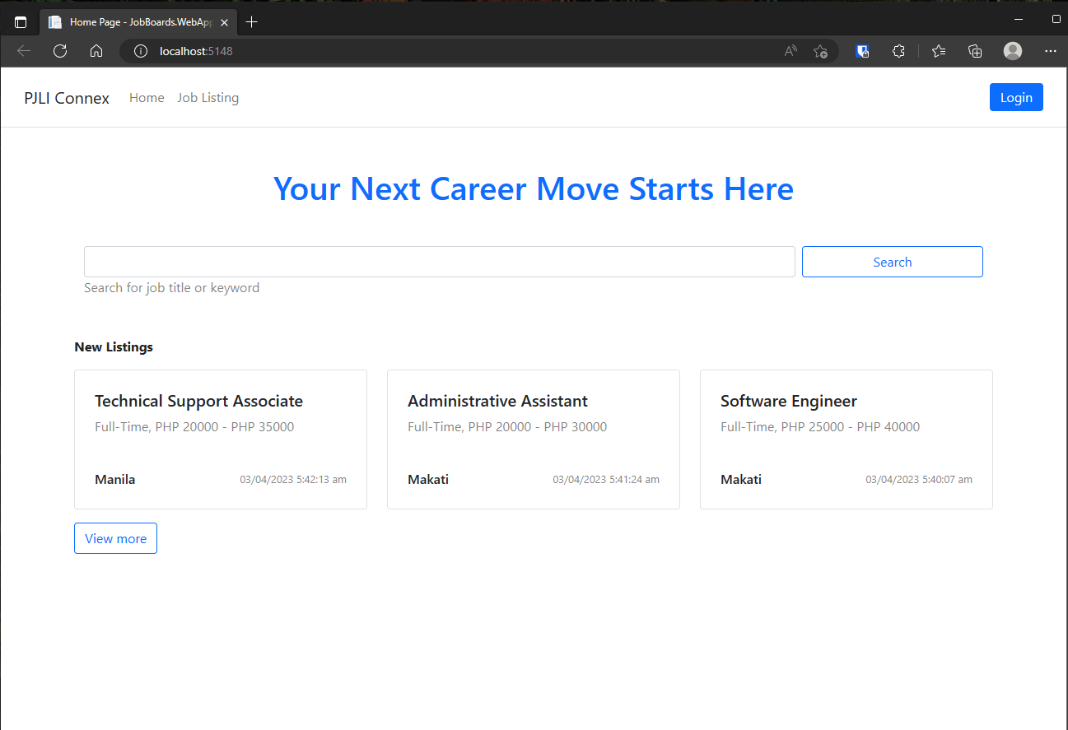
Web APPLICATION
LANDING PAGE
www.collaberadigital.com

Slide 23
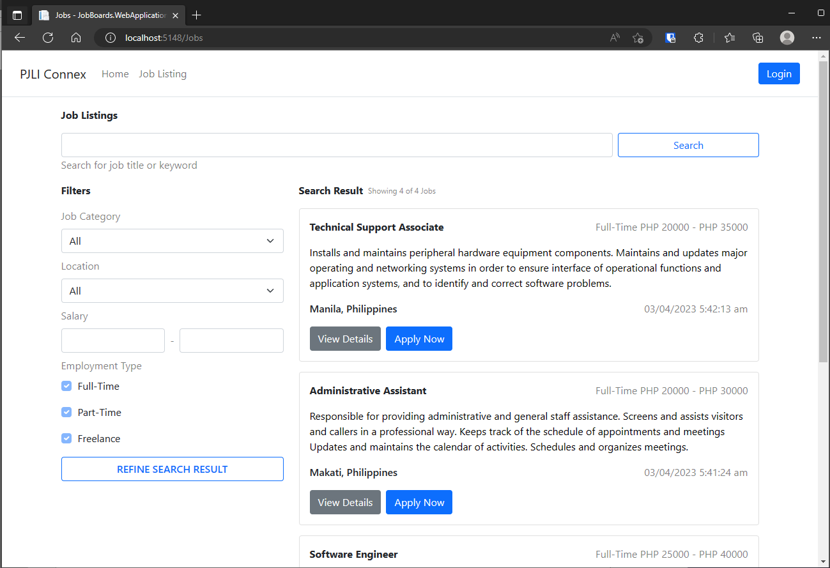
WEB APPLICATION
JOB LISTINGS PAGE
www.collaberadigital.com

Slide 24
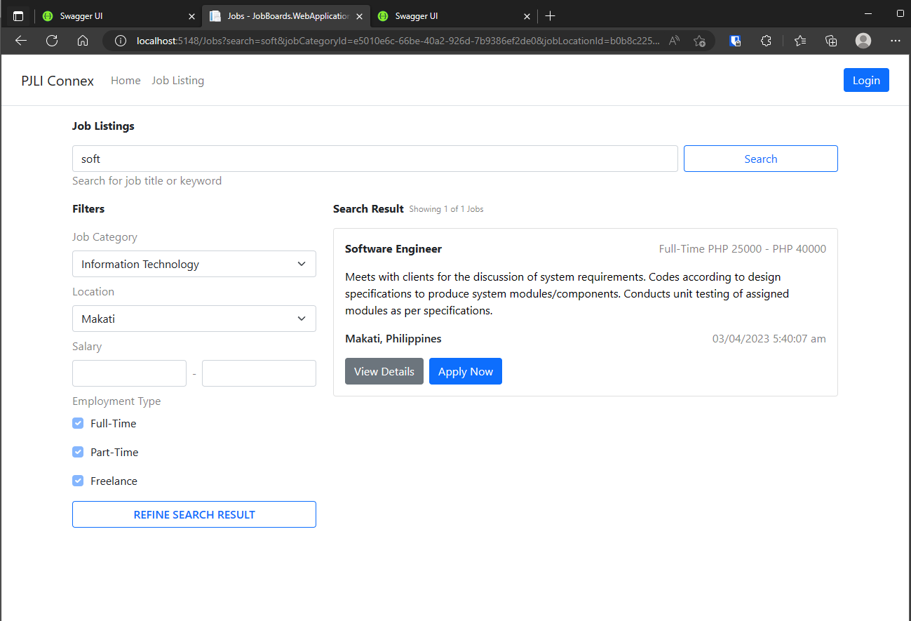
WEB APPLICATION
JOB LISTINGS PAGE – SEARCH & FILTERS
www.collaberadigital.com

Slide 25
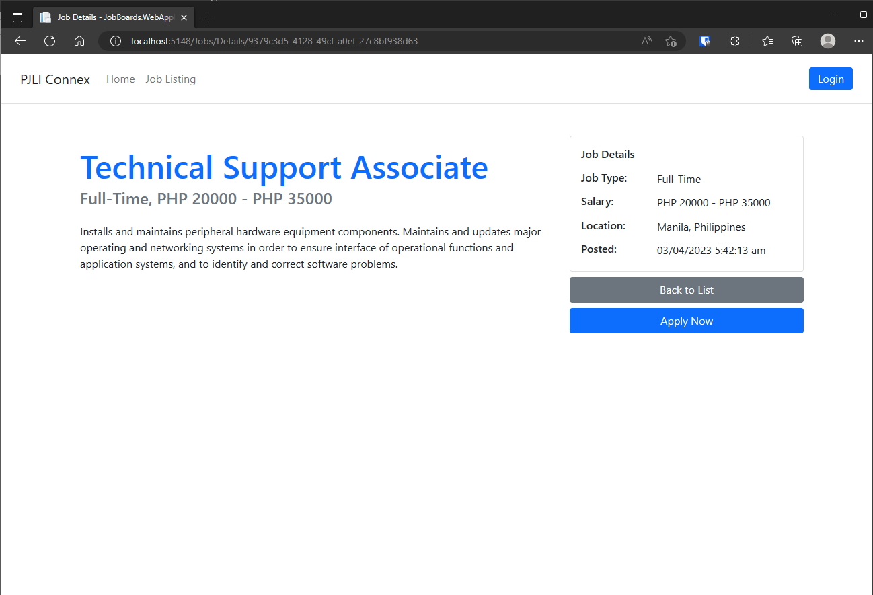
Web APPLICATION
JOB DETAILS PAGE
www.collaberadigital.com

Slide 26
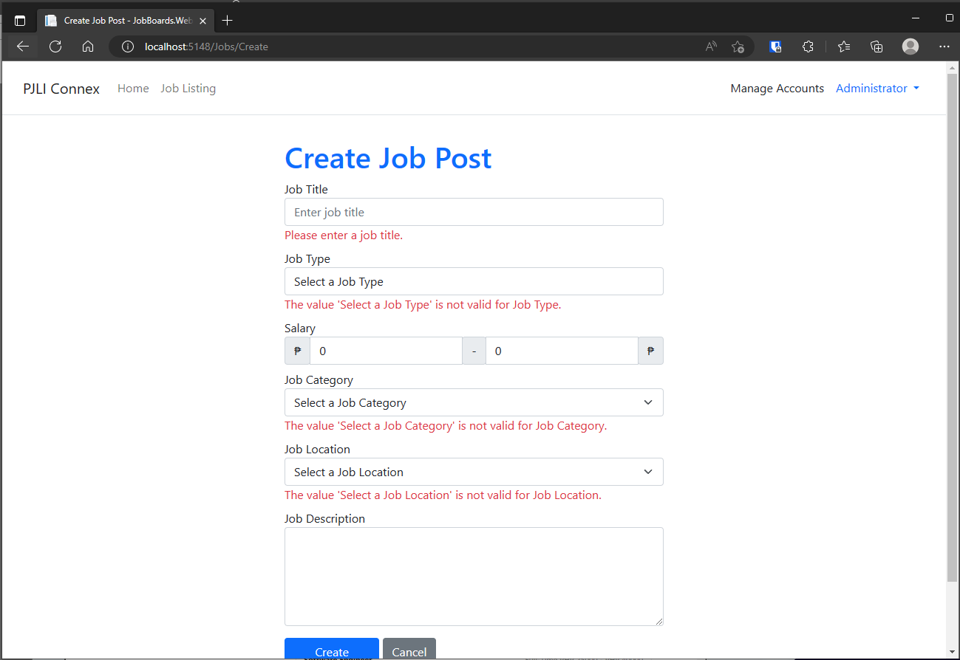
Web APPLICATION
ADMIN – CREATE JOB POST
www.collaberadigital.com

Slide 27
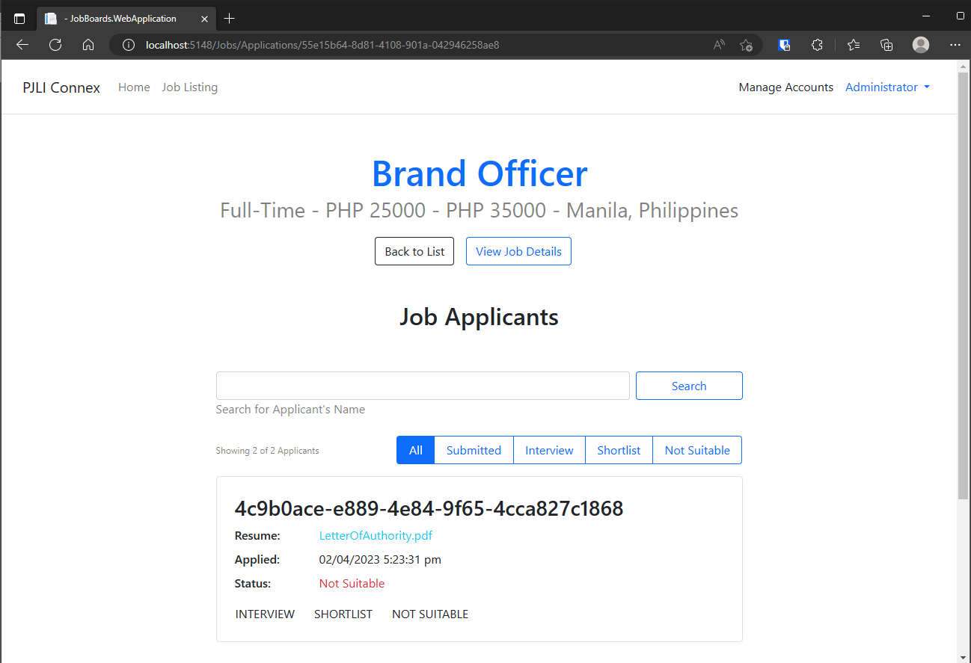
Web APPLICATION
ADMIN – JOB APPLICANTS
www.collaberadigital.com

Slide 28
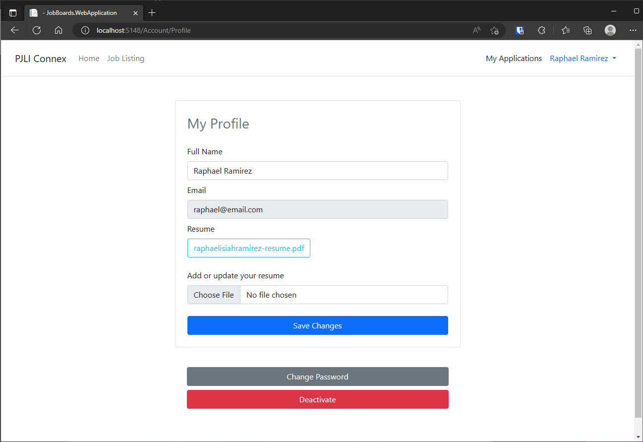
Web APPLICATION
JOBSEEKER – PROFILE
www.collaberadigital.com

Slide 29
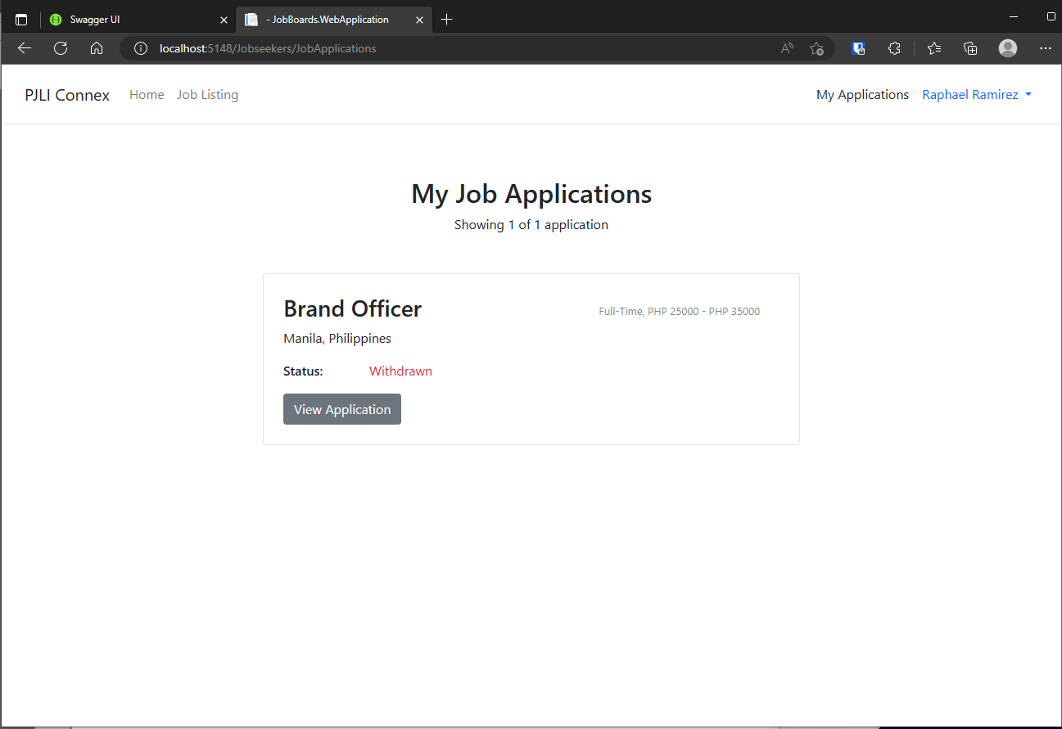
Web APPLICATION
JOBSEEKER – MY JOB APPLICATIONS
www.collaberadigital.com

Slide 30
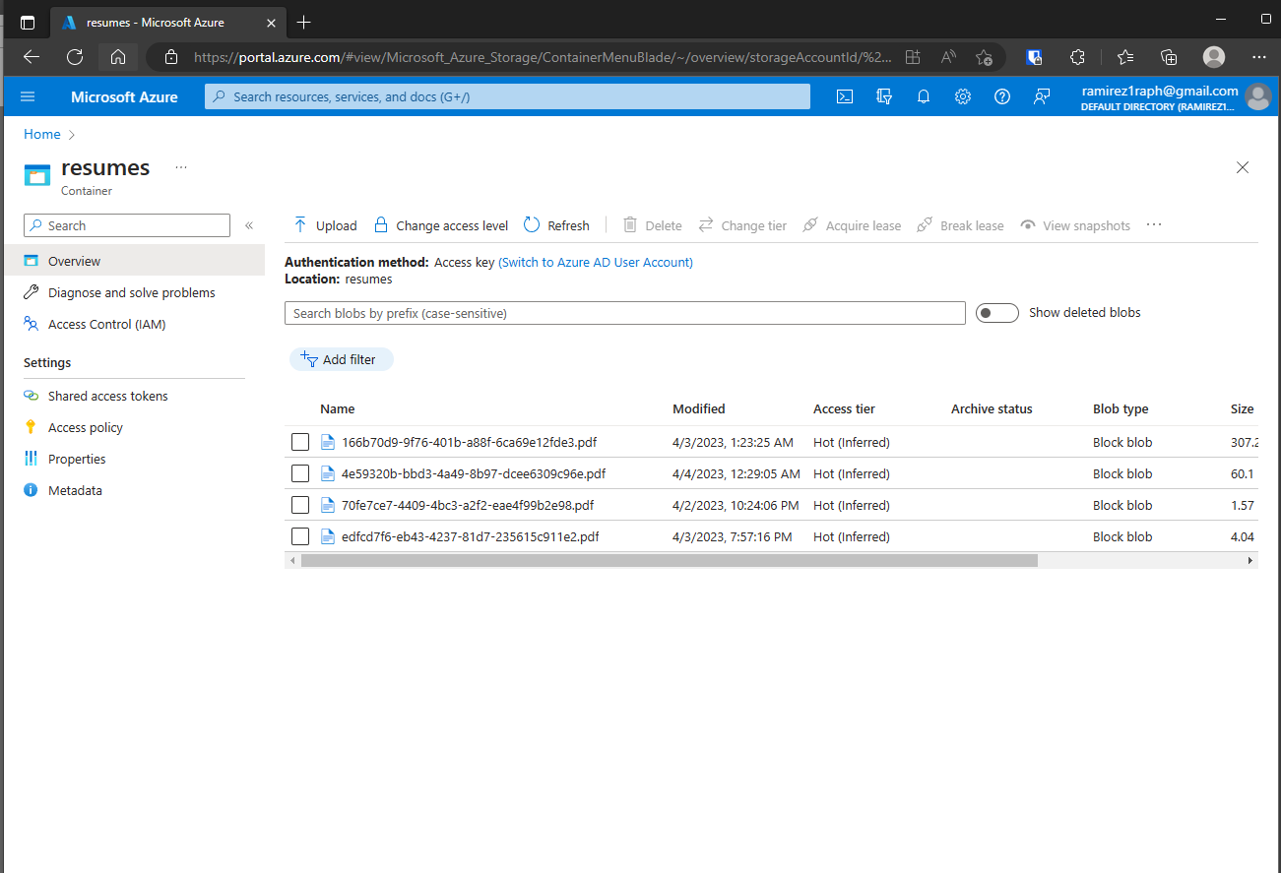
MICROSOFT AZURE STORAGE
UPLOADED RESUMES ARE STORED IN A CLOUD STORAGE
www.collaberadigital.com

Slide 31
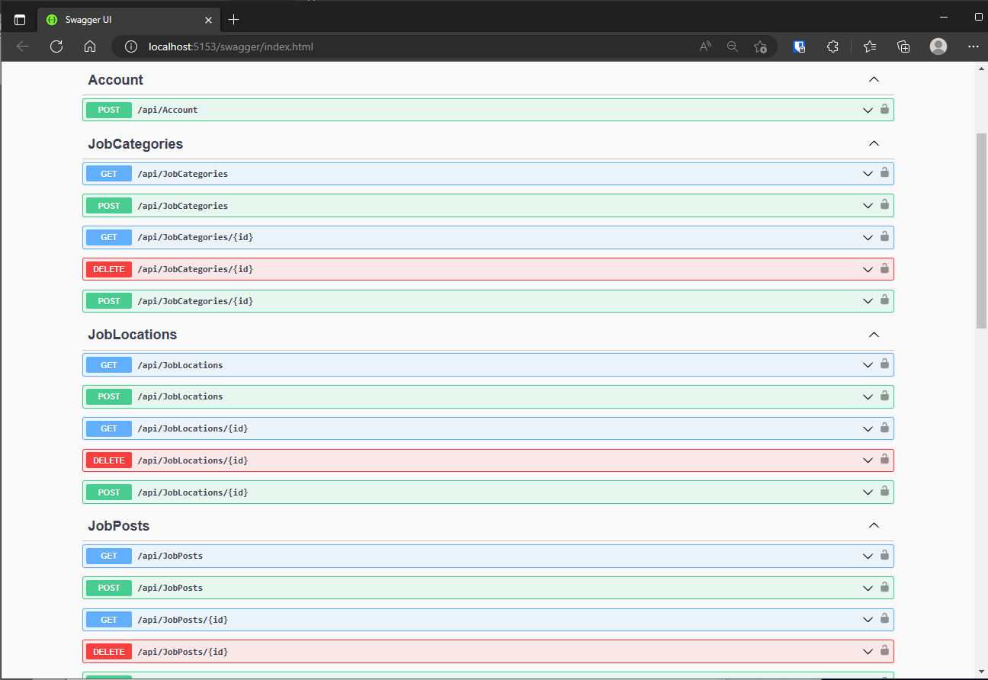
WEB API
Secured APIs to manage the following:
Job Posts
Job Category, Job Type, Job Locations
www.collaberadigital.com

Slide 32
FUTURE ENHANCEMENTS
The system should generate reports on job listing activity, such as the number of views, applications, and hires.
The system should provide analytics on user activity, such as the number of job searches and applications per user.
The system should allow employers to export job application data in various formats, such as CSV or Excel.
The system should allow job seekers and employers to communicate with each other through the platform.
The system should have a messaging system to facilitate communication between job seekers and employers.

Slide 33
TO BE COMPLETED
Filters and Paginations
Activate / Deactivate Job Post
Delete Job Post (Web Application)
Job Applicants Name must be shown instead of their ID. (Job Applicants Page)
Search Job Applicants by Name
Account Management (Employers and Roles Management)
CORS

Slide 34
CONCLUSION
Created a user-friendly application that enhances the job search experience for both job seekers and hiring managers.
Developed a platform that enables employers and hiring managers in PJLI careers to post precise and comprehensive job listings for job seekers.
Effectively classified and filtered job listings to enable job seekers to quickly search and locate suitable job openings in PJLI careers based on their preferences.
Provided a functionality that enables job seekers to effortlessly submit job applications to PJLI careers, while allowing hiring managers to access and download them without any compatibility problems.
Built a user-friendly account management system that simplifies the process for users to manage their resumes, update their personal and professional details, and track the progress of their job applications.

Slide 35

Thank you!
www.collaberadigital.com

